Slide 1

Lockd
By Heidi Ginnaw

Slide 2
Project Vision
Secure Notes Application:
Users will be able to save files
Files should be encrypted then stored
Application will be easy to navigate
Users log in to access their notes
Users’ passwords stored with argon2
Note details can only be seen if chosen

Slide 3
Background
Security best practices:
Open Worldwide Application Security Project (OWASP)
Argon2
Salting
Other similar products:
Standard notes

Slide 4
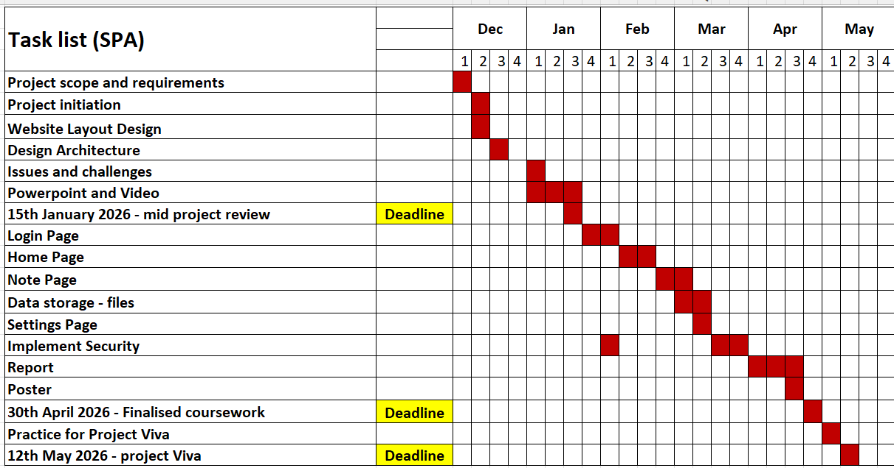
Project Plan

Slide 5
Sprints so far
Sprint 1 (26/11/2025 – 9/12/2025)
User Stories
As a developer, I want to set up the infrastructure so I can start building the website
As a user, I want the website to be easy to navigate
Tasks
Set up repository
Download extensions and required software
Create sitemap
Create base wireframe
Create individual ‘page’ wireframes
Deliverables
The software is set up, so when the design is ready, I can start programming. The layout of the website is designed so program architecture can now be designed.

Slide 6
Sprints so far
Sprint 2 (9/12/2025 – 23/12/2025)
User Stories
As a developer, I want the website to be easy to program and maintain
As a user, I want all my notes to be encrypted to ensure that they are secure
Tasks
Create class diagrams
Research best encryption methods
Research best security practices
Plan the security for the website
Deliverables
The architecture of the code is designed, so when programming starts it is easy to know what to code , and the security has been researched and planned.

Slide 7
Sprints so far
Sprint 3 (1/1/2026 – 15/1/2026)
User Stories
As a developer, I want to complete the mid project review
Tasks
Create the slides
Record the video
Write my professional development review
Deliverables
The slides and video explaining the scope of my project and work so far will be done and my professional development review will be submitted.

Slide 8
Next Sprint
Sprint 4 (15/1/2026 – 29/1/2026)
User Stories
As a user, I want my notes to be kept secure behind a login page
Tasks
Design and implement a login page, that after a successful login, opens to the home page
Securely hash and store the password
Deliverables
The login page will be complete, with the usernames and passwords being stored securely.

Slide 9
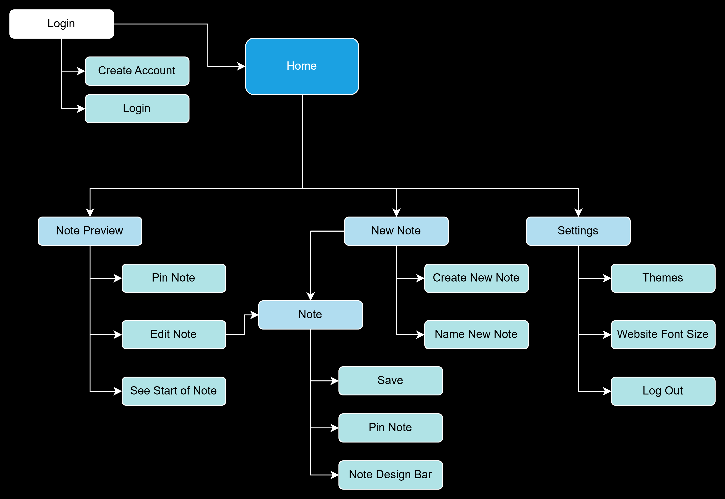
UML Models
Sitemap

Slide 10
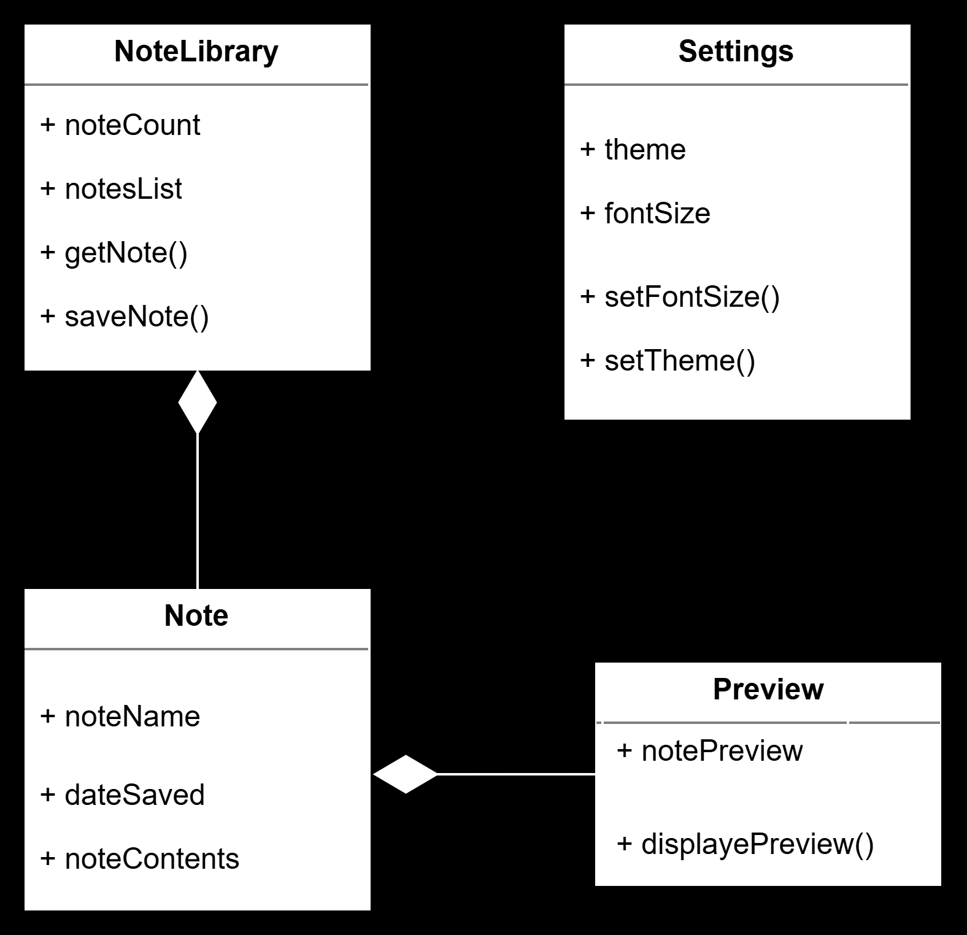
UML Models
Class Diagrams

Slide 11
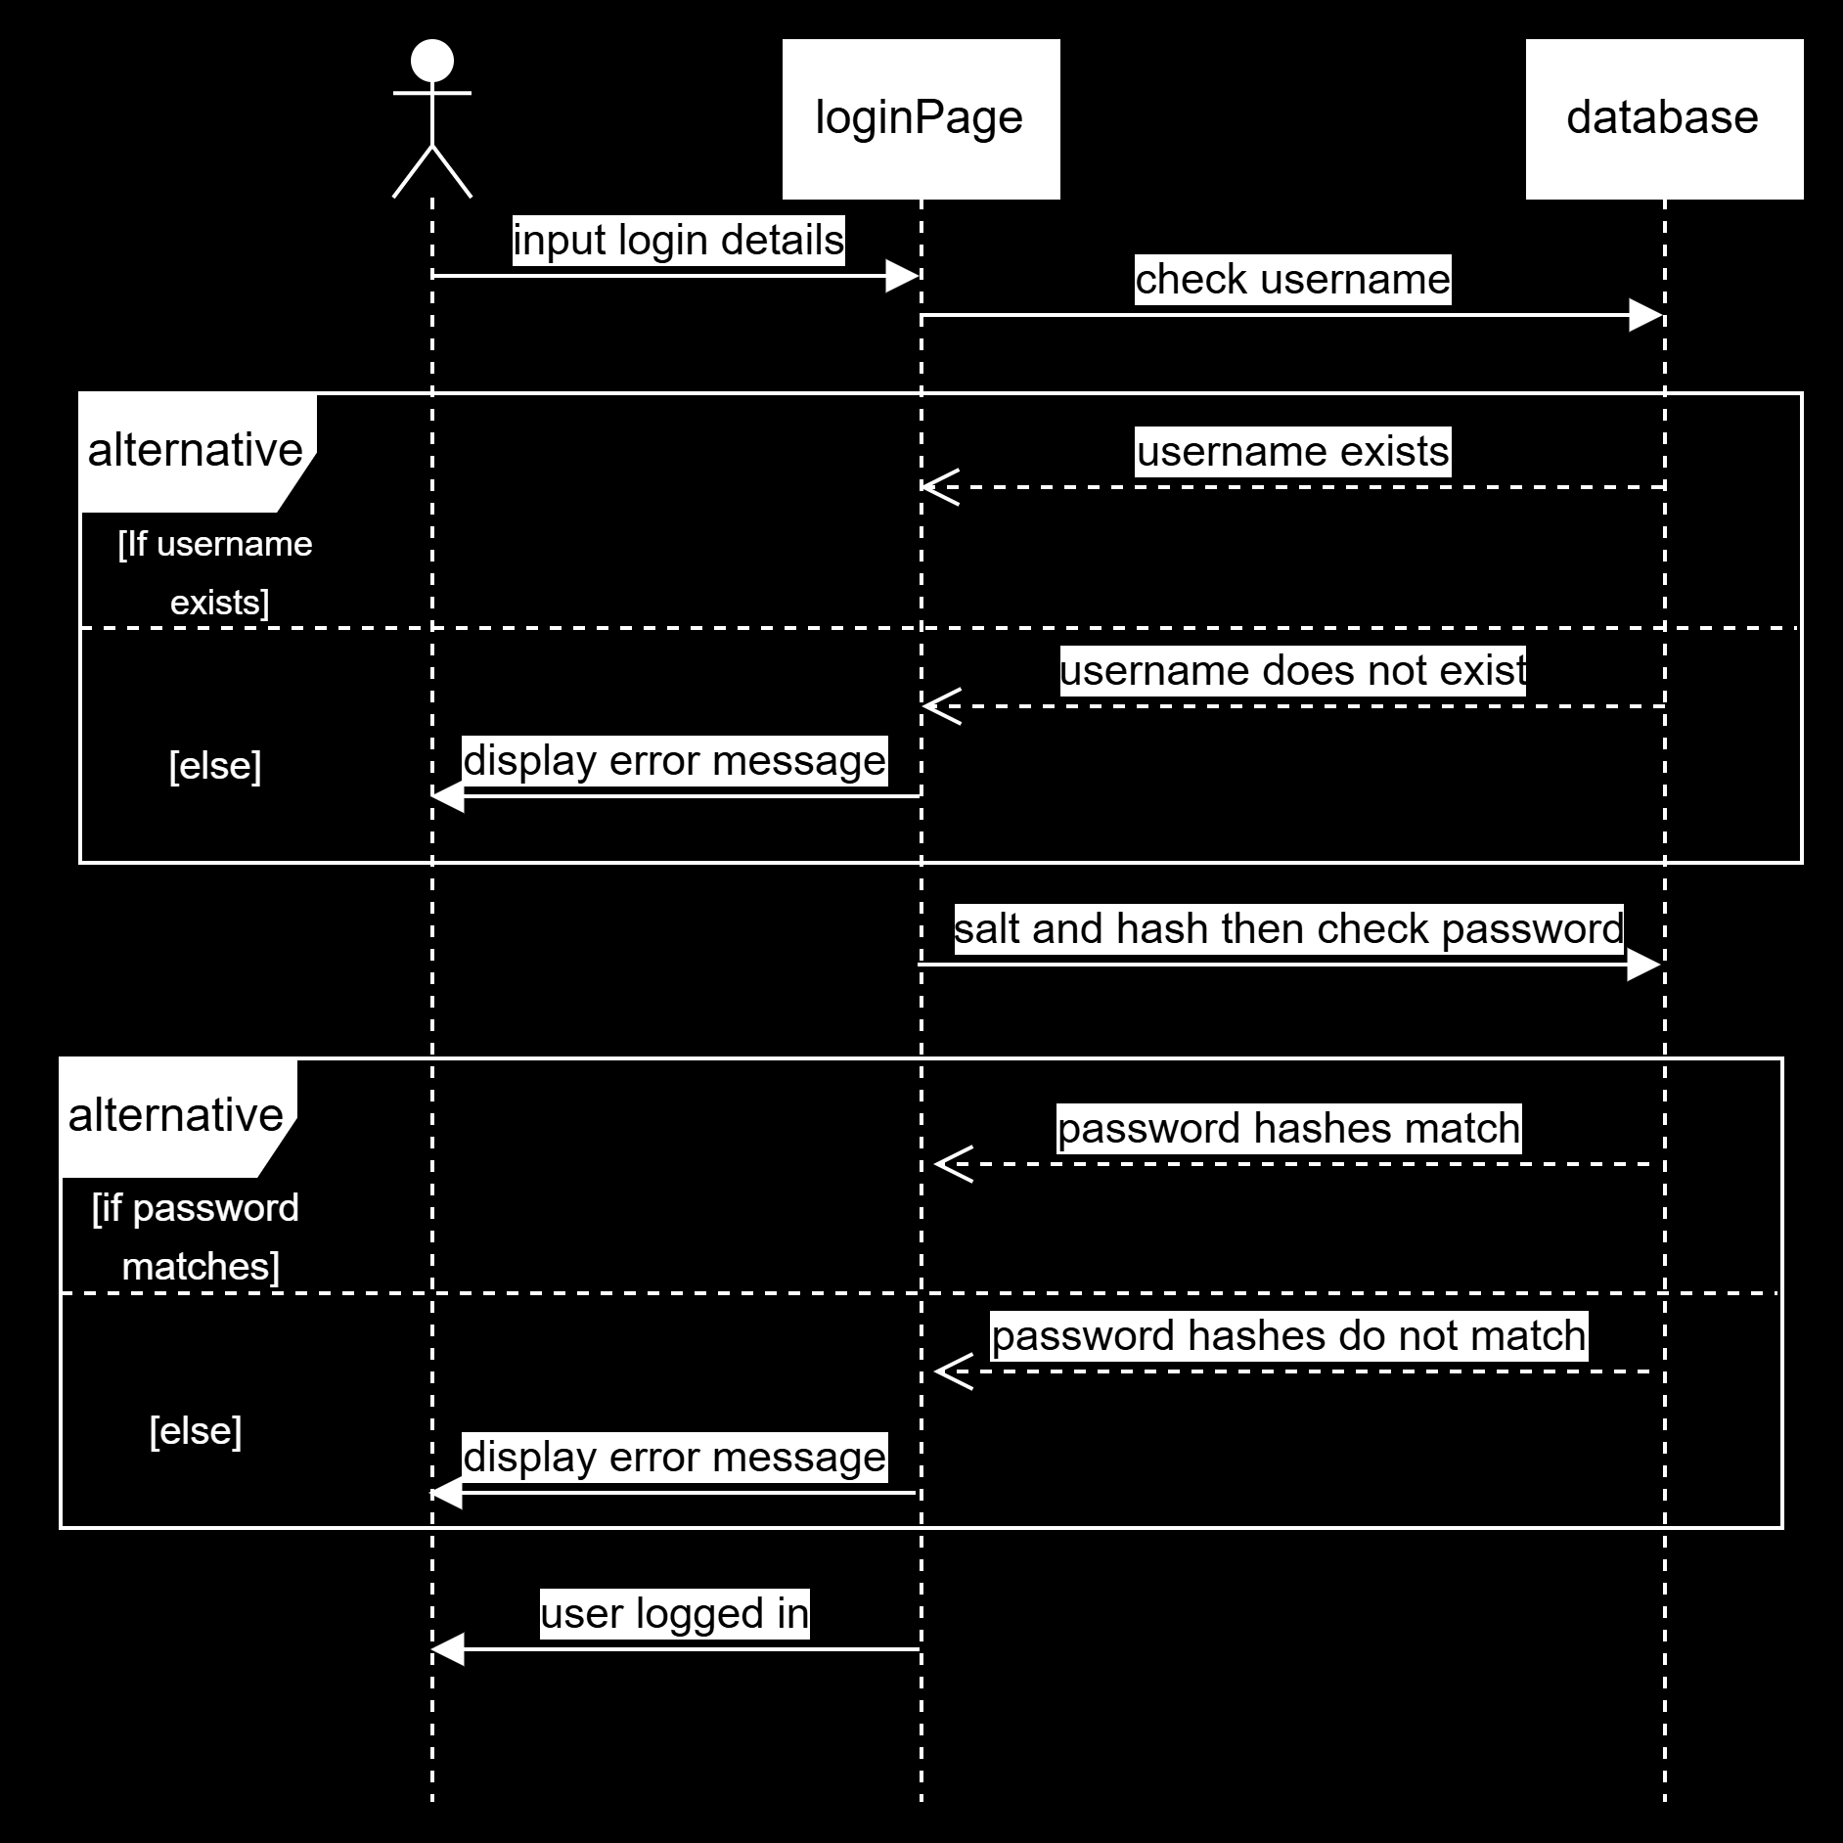
UML Models
Login Sequence Diagram

Slide 12
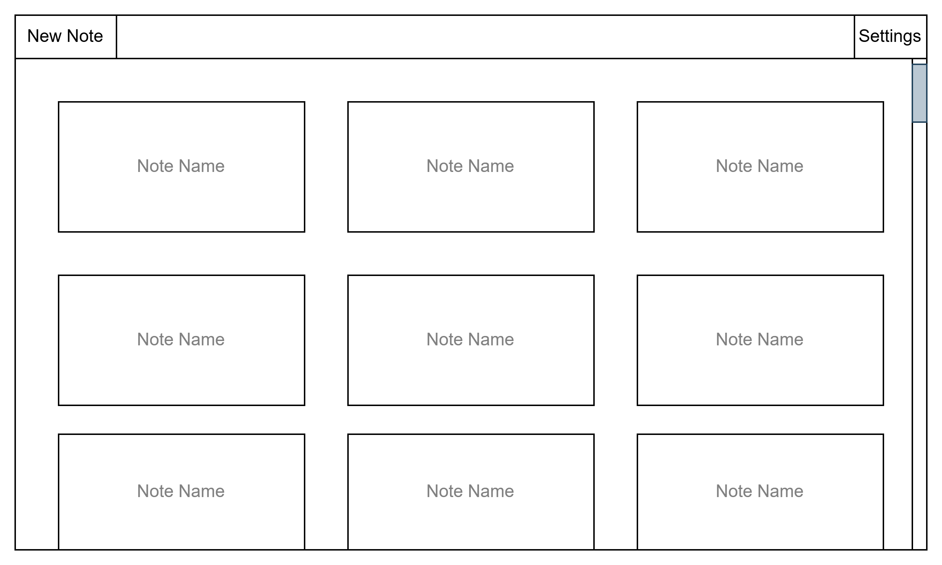
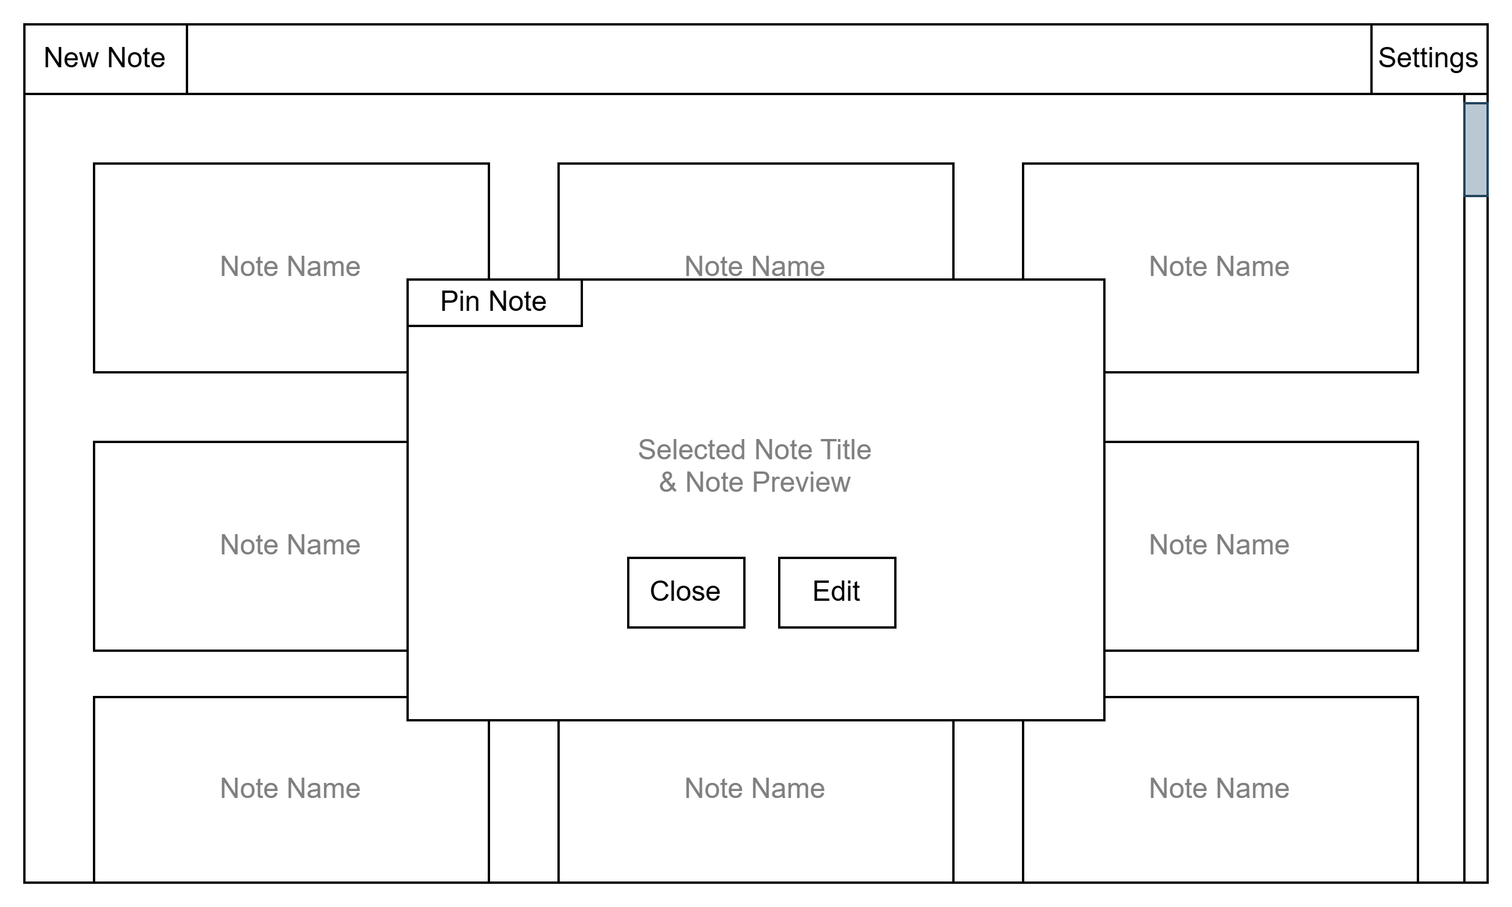
Prototype
Wireframes

Slide 13
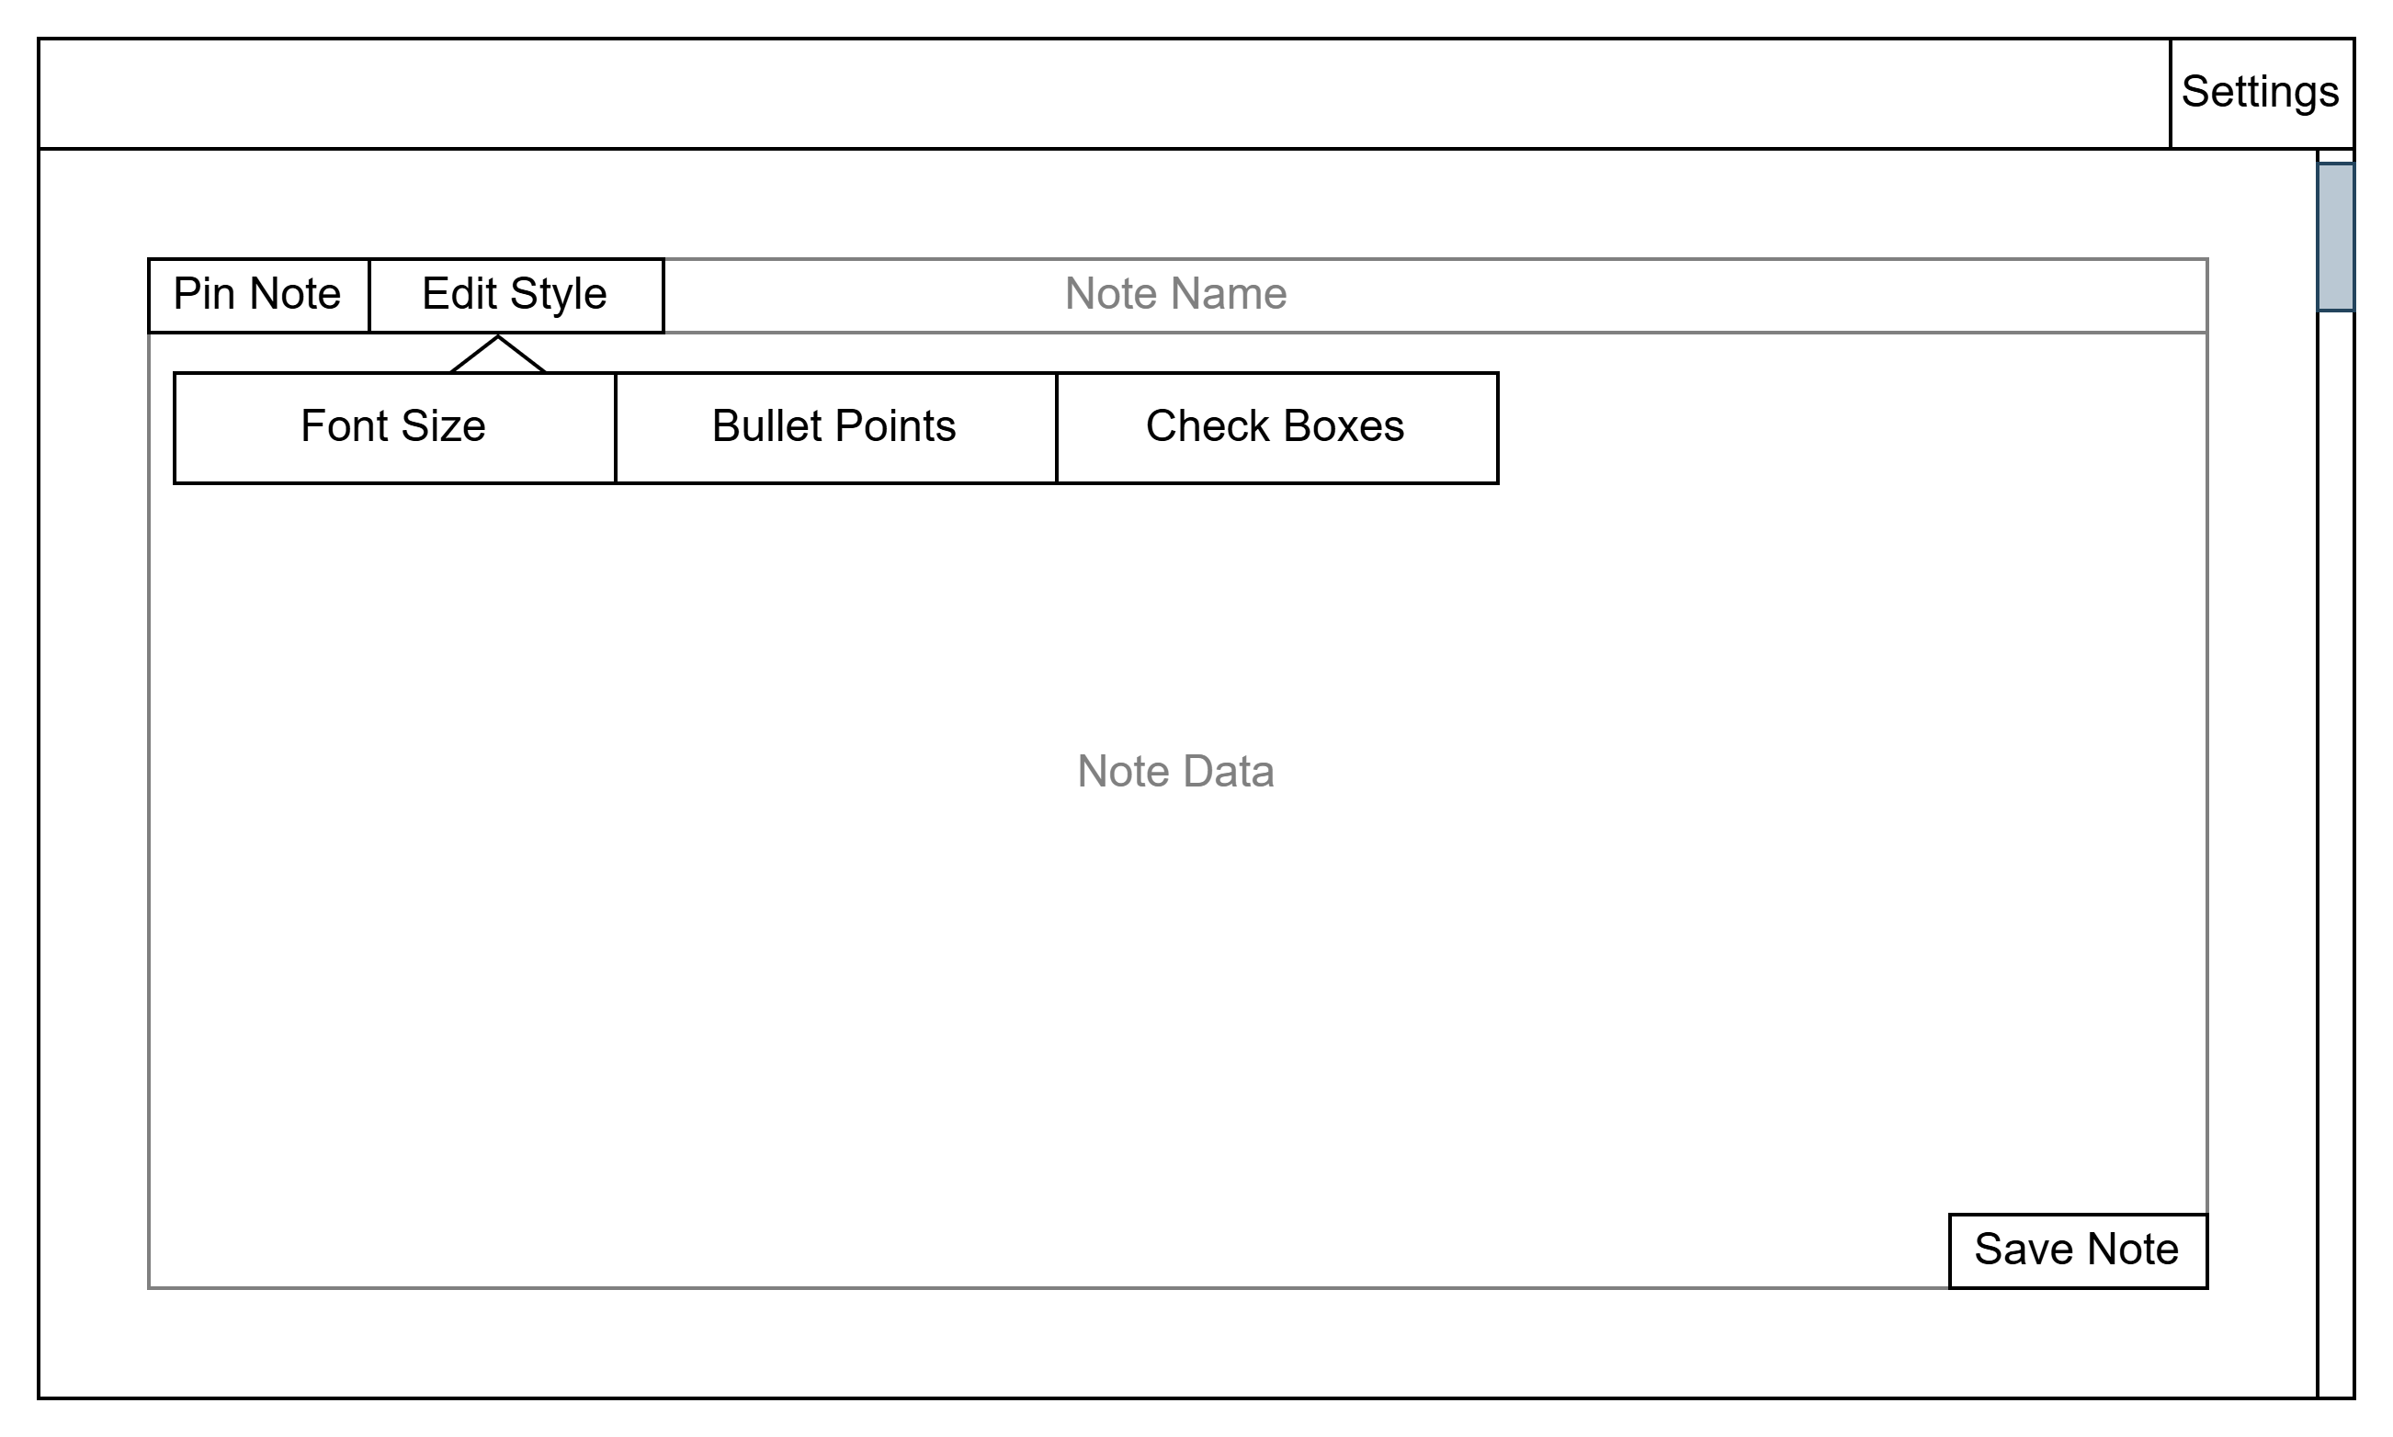
Prototype
Wireframes

Slide 14
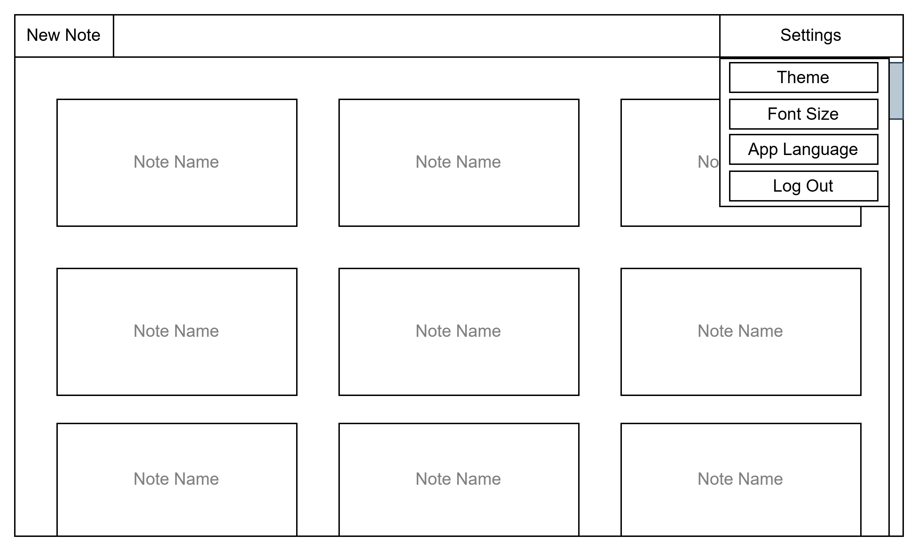
Prototype
Wireframes

Slide 15
Issues and challenges
Using argon2
Encrypting files and performance

Slide 16
Thank You for listening!

Slide 17
References
https://owasp.org/Top10/2025/
https://standardnotes.com/features

